Slide 1
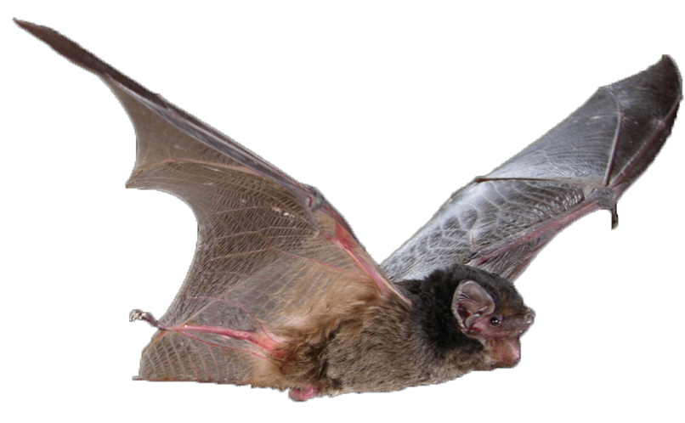

All About Micro-Bats
BURNETT MARY MICRO-BAT EDUCATION KIT
Investigating Insectivores
PHOTO: Michael Pennay

Slide 2
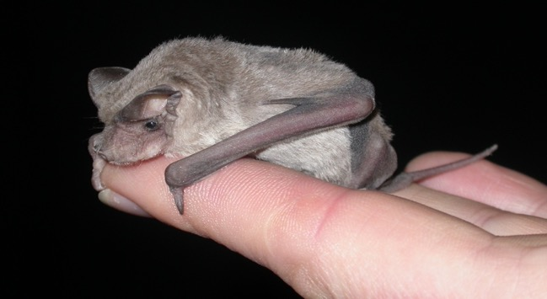
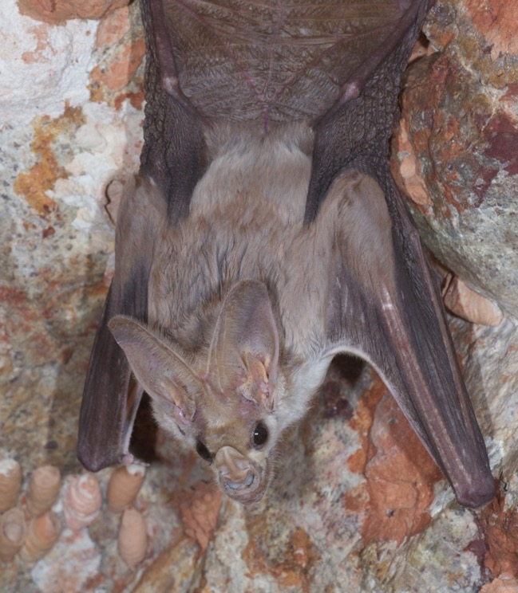
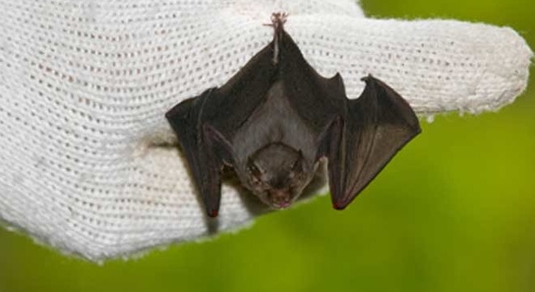
Welcome to the Micro-bat world
Approximately 70% of bats are micro-bats.
There are 68 species of micro-bats in Australia
Micro-bats are about the size of a mouse
Thailand’s Bumblebee bat is the smallest in the world
The Ghost bat is Australia’s largest micro-bat
PHOTOS: (Left-top) Terry Reardon, (Left-bottom) Yushi Osawa, (Right) Les Hall
Notes:
Micro-bats are small and the average body is about the size of a mouse. They are often called ‘flying-mice’.
The smallest bat in the world is the critically endangered Bumblebee bat of Thailand. It is only 29-33 millimetres in length, approximately 2 grams in weight and has a wingspan of up to 15 centimetres.

Slide 3
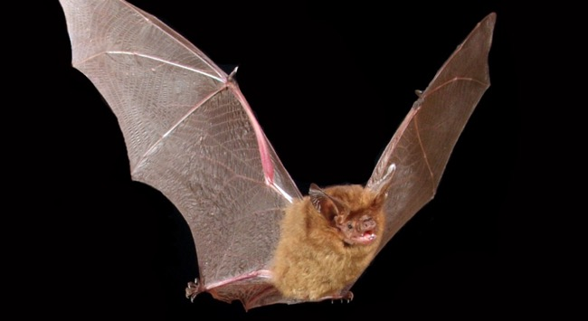
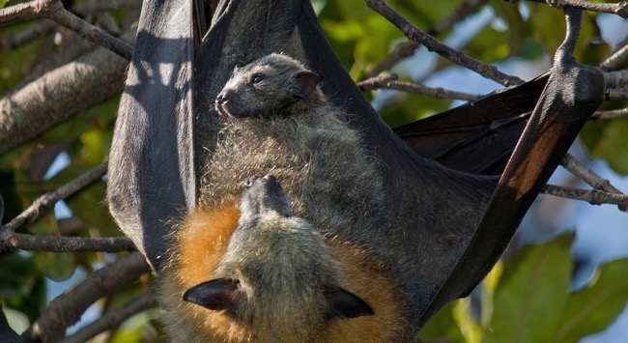
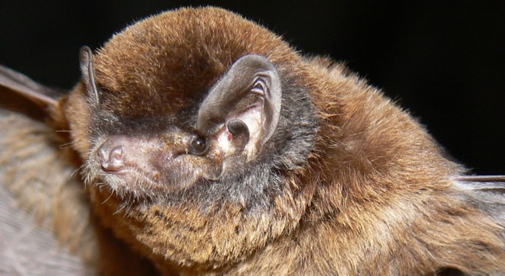
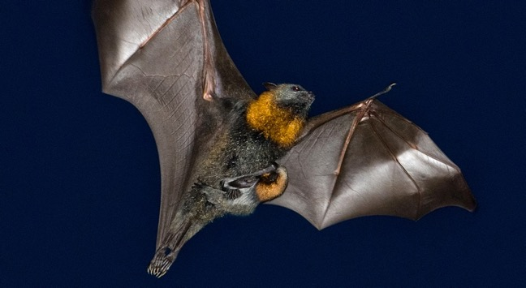
All Bats are mammals
Only true flying mammal
Give birth to live young
Have fur, skin and are warm blooded
Suckle young with milk
PHOTOS: (Left-top) Michael Pennay, (Left-bottom) Les Hall, (Right-both) Nick Edards
Notes:
All bats are mammals. Mammals are animals that care for their young after birth by feeding them milk. Most mammals give birth to live young. They all have fur or hair on their bodies. Human beings are mammals as well as dogs, cats, kangaroos and whales. Bats are the only mammal that can fly.

Slide 4
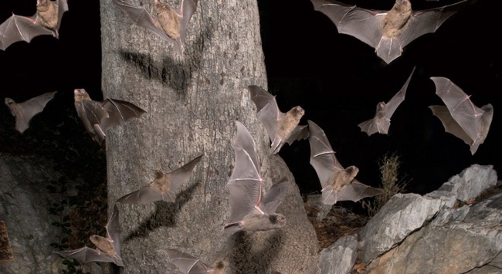
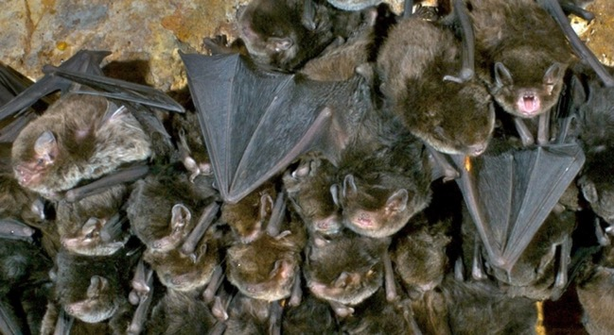
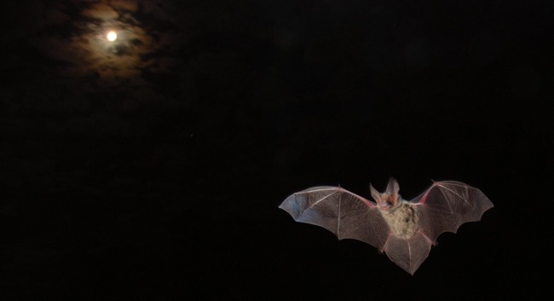
All Bats are nocturnal
All bats sleep/rest during the day and feed at night
The hang upside-down in their roost during the day to save energy
There are fewer predators at night
Food is often more accessible at night
PHOTOS: (Top) Les Hall, (Bottom) Michael Pennay
Notes:
Bats are nocturnal. They wake up at dusk and fly out to feed and find water. They return to the roost early in the morning.
Bats sleep or rest by hanging upside down, using a special claw on their foot which ensures that they won’t let go when they’re asleep. By hanging upside-down they don’t waste any energy.

Slide 5
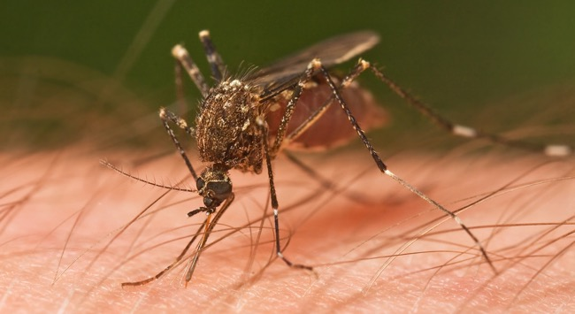
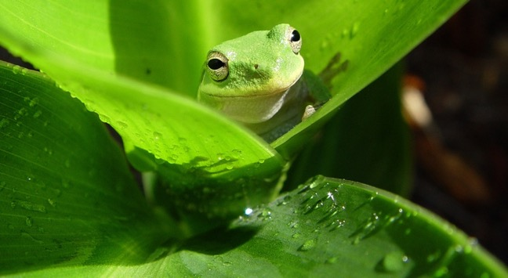
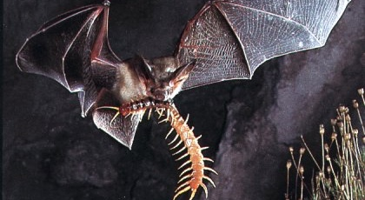
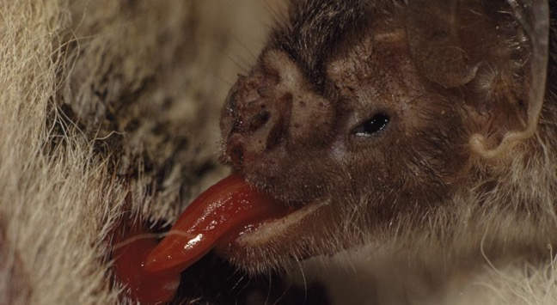
A Micro-bat’s Diet
Mosquitoes and other flying insects
Some eat small frogs, fish and reptiles
There are no
Vampire bats
in Australia
Non-flying insects
Vampire bats drink blood
PHOTOS: (Left-top) JJ Harrison/Wikipedia, (Left-bottom) www.reed.edu, (Right-top) Stock Images, (Right-bottom) Bruce Dale/National Geographic
Notes:
A micro-bat’s diet largely consists of insects but can include small mammals, frogs, fish.
Occasionally a micro-bat’s diet can include fruit, pollen, nectar and blood - this is not the normal food for Australian micro-bats.

Slide 6
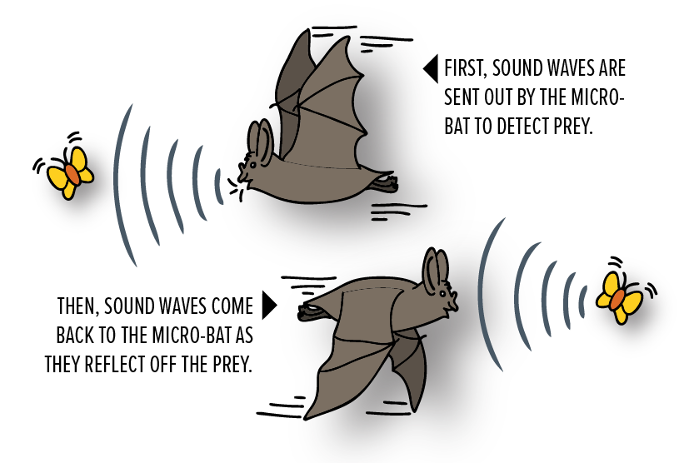
Seeing in the dark
Micro-bats do not rely on sight to find food. Instead they use a form of radar called ECHOLOCATION.
Micro-bats use echolocation to find their food and their surroundings by bouncing sound waves off objects and listening to the echo.
DIAGRAM: Kelly Coleman/PeeKdesigns
Notes:
Micro-bats do not rely on sight to find food. Instead they use a form of radar called echolocation.
Micro-bats echolocate by bouncing sound waves off objects and listening to the echo.

Slide 7
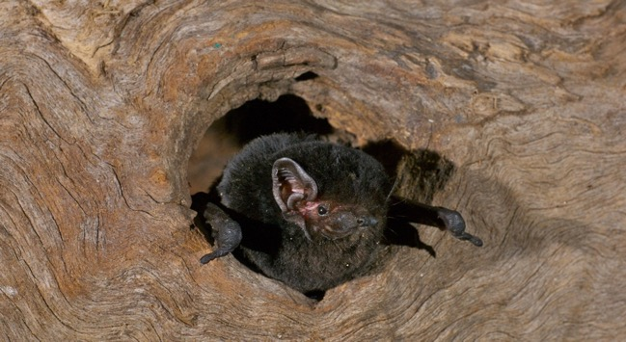
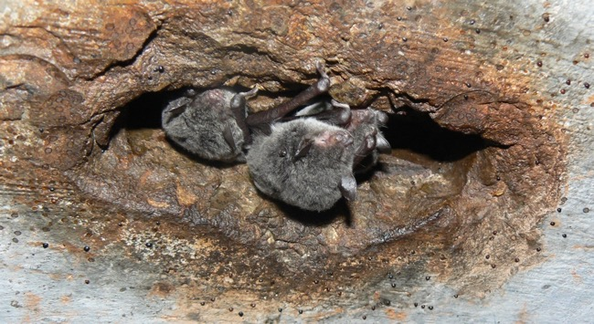
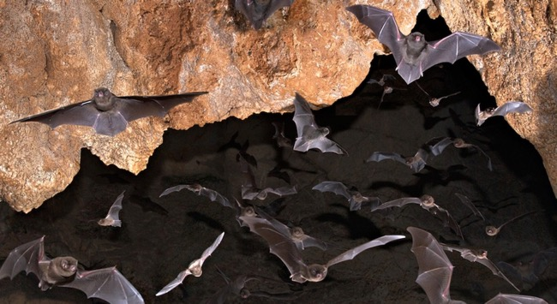
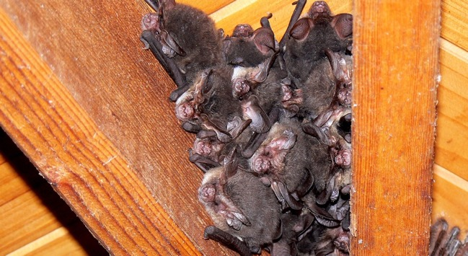
There’s no place like home
Tree hollows
Man-made drains and structures
Caves and crevices
Houses and other buildings
PHOTOS: Les Hall
Notes:
Most Australian micro-bats will roost in tree hollows or under bark, or they can be found in caves and cave-like structures.
They can also find shelter in roofs or sheds when there aren’t enough ‘natural’ roosts around.

Slide 8
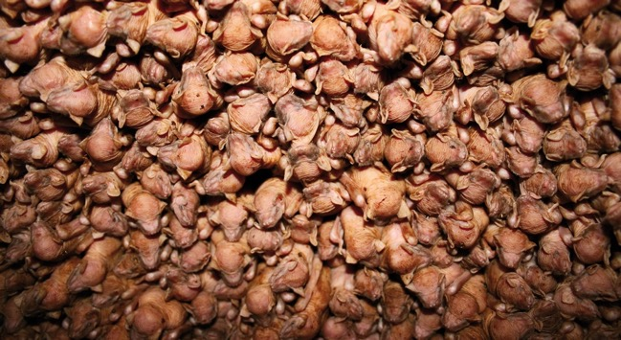
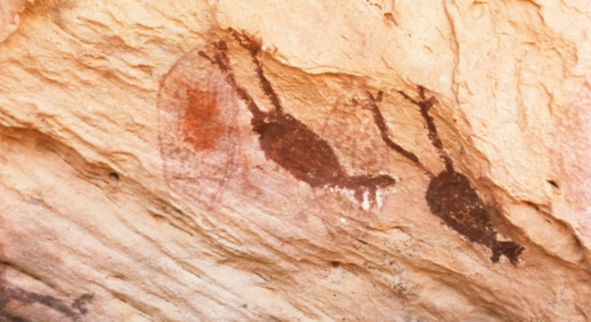
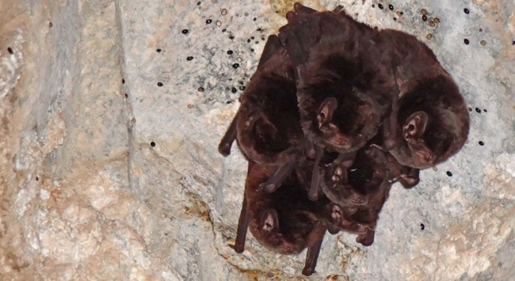
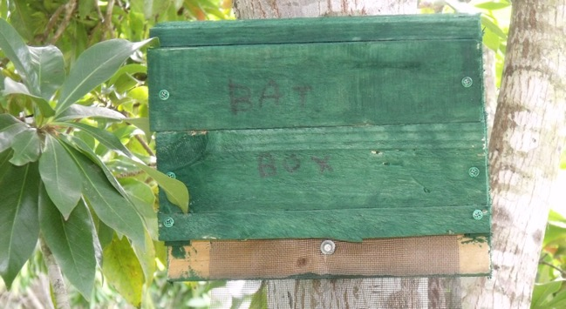
Other Fun Facts
Maternity colonies can have thousands of individual mothers and babies
Bats have been around for 52 million years
Micro-bats will hibernate in cold weather
Bat boxes provide roosts for micro-bats
PHOTOS: (Top) Les Hall, (Bottom) John Parsons
Notes:
MATERNITY COLONIES: Micro-bats also have nurseries where the young are left in large groups while the mothers feed at night. Mothers will gather in the same area, sometimes a cave, tree hollow or building cavity. These nurseries can consist of millions of bats in some areas.
HIBERNATION: Food can be scarce in winter, so micro-bats survive by either migrating to warmer regions or they hibernate. Hibernation is a state of torpor (inactivity). Micro-bats have the ability to slow their heart rate and lower their body temperature, sometimes to as low as 2°C.
HISTORY: The oldest known bat fossil is 52 million years old. Research show it could fly, but not use echolocation. Bats have been used as food sources, they feature in Dreaming stories, found in cave paintings and in modern art, as well as being totem animals for some Indigenous groups.
CONSERVATION: Loss of habitat is the single largest threat to all bats. Bat boxes can be easily built and erected around schools and homes to provide daytime roosts for micro-bats.

Slide 9
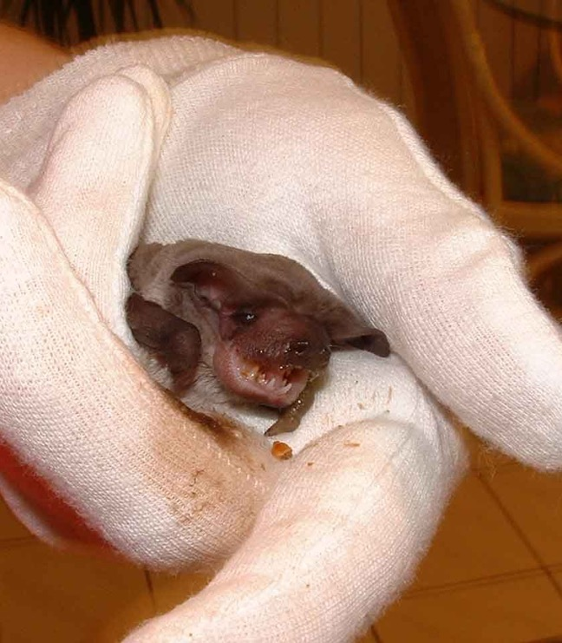
Leave bats alone
This rescued micro-bat is being
cared for by a trained and
vaccinated professional.
All Australian bats have the potential to carry diseases.
If you find a sick or injured bat, do not touch the bat. Contact a local vet for details or your nearest wildlife carer
or call 13HEALTH information line
(13 432584)
The best approach is to leave bats alone.
PHOTO: www.batrescue.org.au
Notes:
Like other wild animals, some bats may carry viruses that can be transmitted to humans. The two major viruses that have been identified in some bats includes the Australian Bat Lyssavirus and the Hendra Virus – both viruses can be fatal!
If you find a sick or injured bat, do not touch the bat. Contact a local vet for details or your nearest wildlife carer.

Slide 10
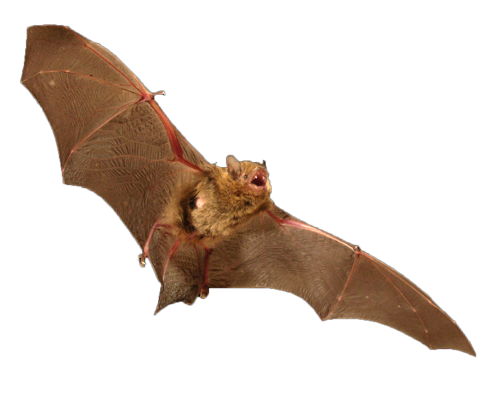
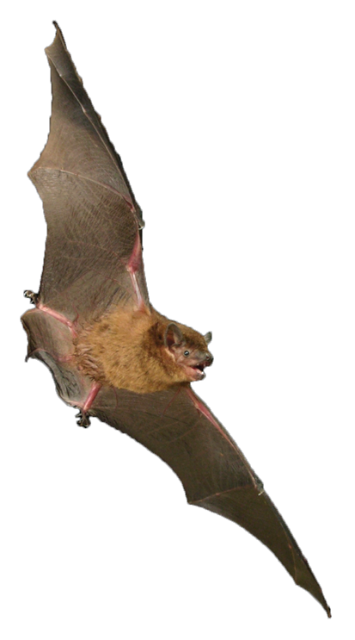
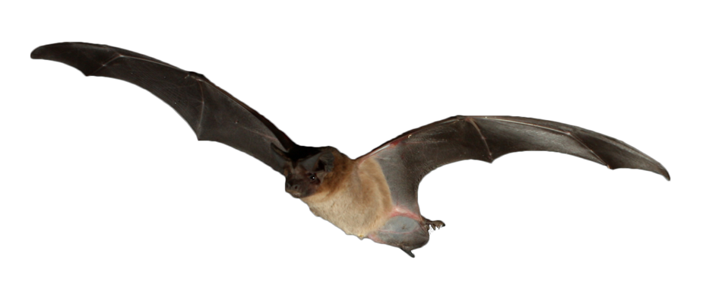

allaboutbats.org.au
Burnett Mary Micro-Bat Education Kit: Investigating Insectivores
© 2018 PeeKdesigns
This project is supported by Burnett Mary Regional Group for Natural Resource Management Ltd, through funding from the Australian Government’s National Landcare Program.
PHOTOS: Michael Pennay

