Slide 1
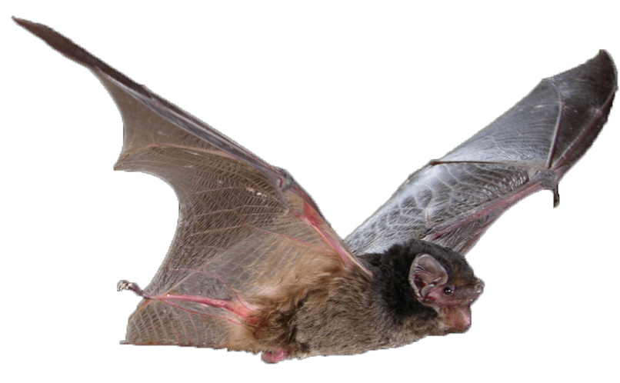

Micro-Bat Habitat
BURNETT MARY MICRO-BAT EDUCATION KIT
Investigating Insectivores
PHOTO: Michael Pennay

Slide 2




What is Habitat?
All animals have certain things that they need to survive.
Oxygen
to breathe
Water
to drink
Food
for energy
Shelter
for protection
The combination of where all these things are located is an animal’s habitat.
Notes:
Everywhere an animal travels, rests and stops is known as their habitat.
Our habitat includes: home, supermarket, friends or family that we visit, school, park – anywhere we spend time.

Slide 3
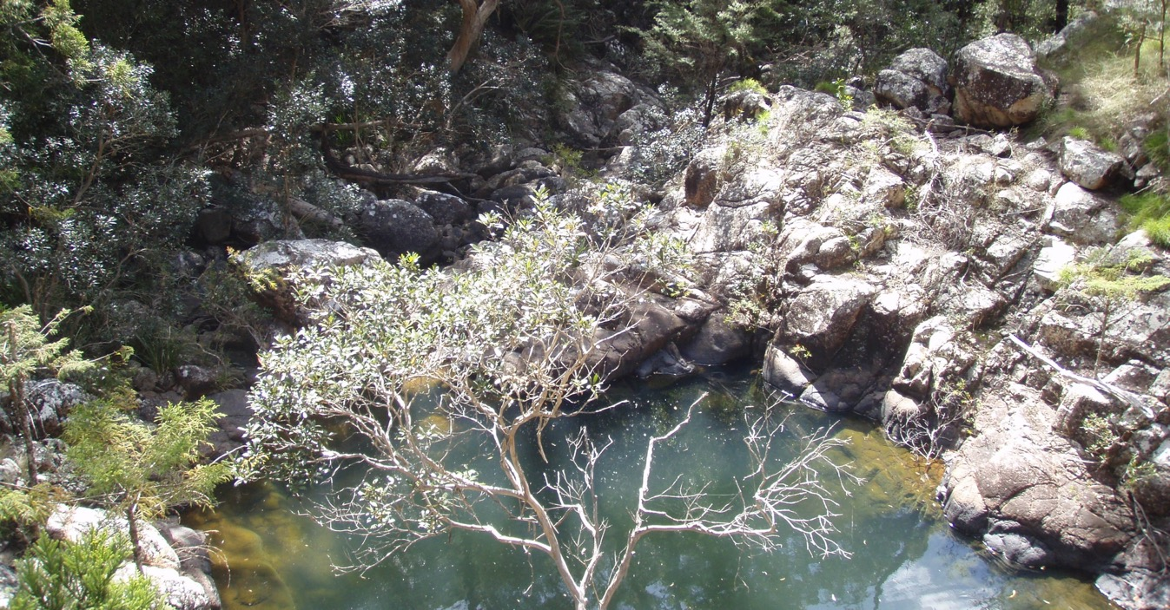
Where do micro-bats live?
Shelter
Food flying around
Water
PHOTO: Rod Buchanan
Notes:
Micro-bat habitat includes:
Shelter – such as trees or caves
Food – abundant insects to eat
Water – micro-bats will wet their belly and lick their fur to get extra water that they don’t get from their food

Slide 4
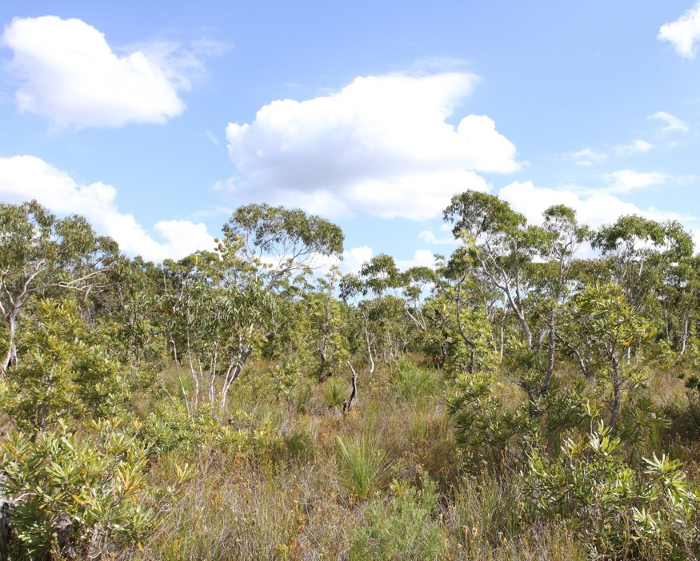
Natural Habitat
Rainforests
Forests
Woodlands
Grasslands
Heathland
Coastal areas
Escarpments
(cliffs and caves)
PHOTO: Rod Buchanan

Slide 5
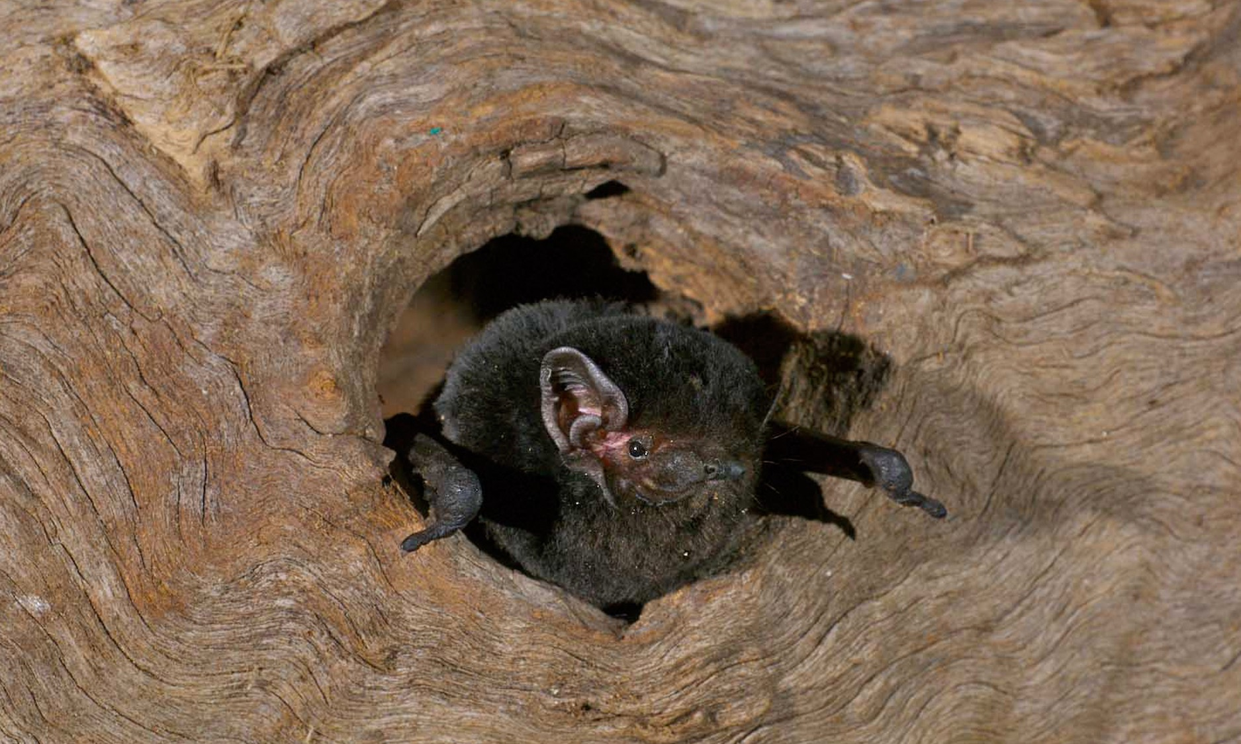
Hollows & under bark
PHOTO: Les Hall
Notes:
Forest dwelling micro-bats take up roost in tree hollows, sometimes very small spaces. They can even be found under bark.
Trees take a long time to form hollows, this is why it is important to keep forests and woodlands as they are home for many animals.

Slide 6
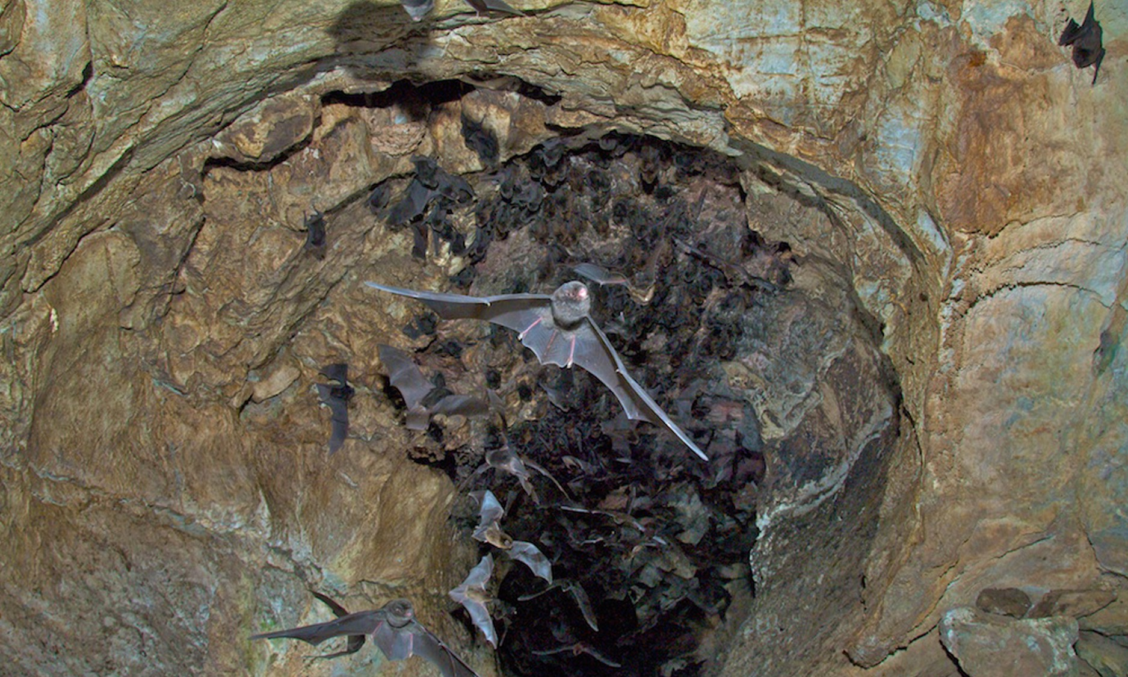
Caves & Rocky Outcrops
PHOTO: Les Hall
Notes:
Cave dwelling micro-bats don’t always need huge caverns to roost in. Even small rocky outcrops and crevices will do.
However, maternity colonies need more room and can be found in larger caves.

Slide 7
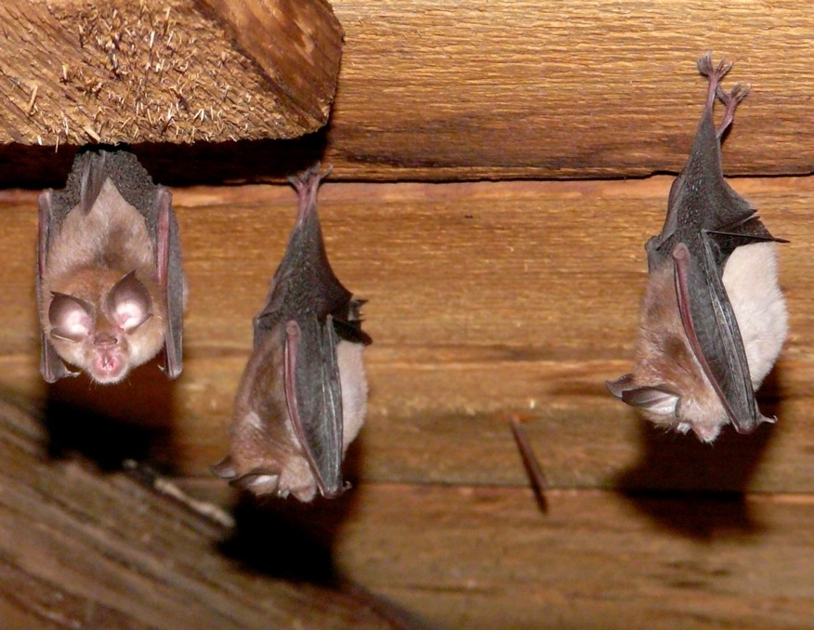
Man-Made Habitat
Houses
Farmland
Buildings in cities
Abandoned mines
PHOTO: www.bats.org.au

Slide 8
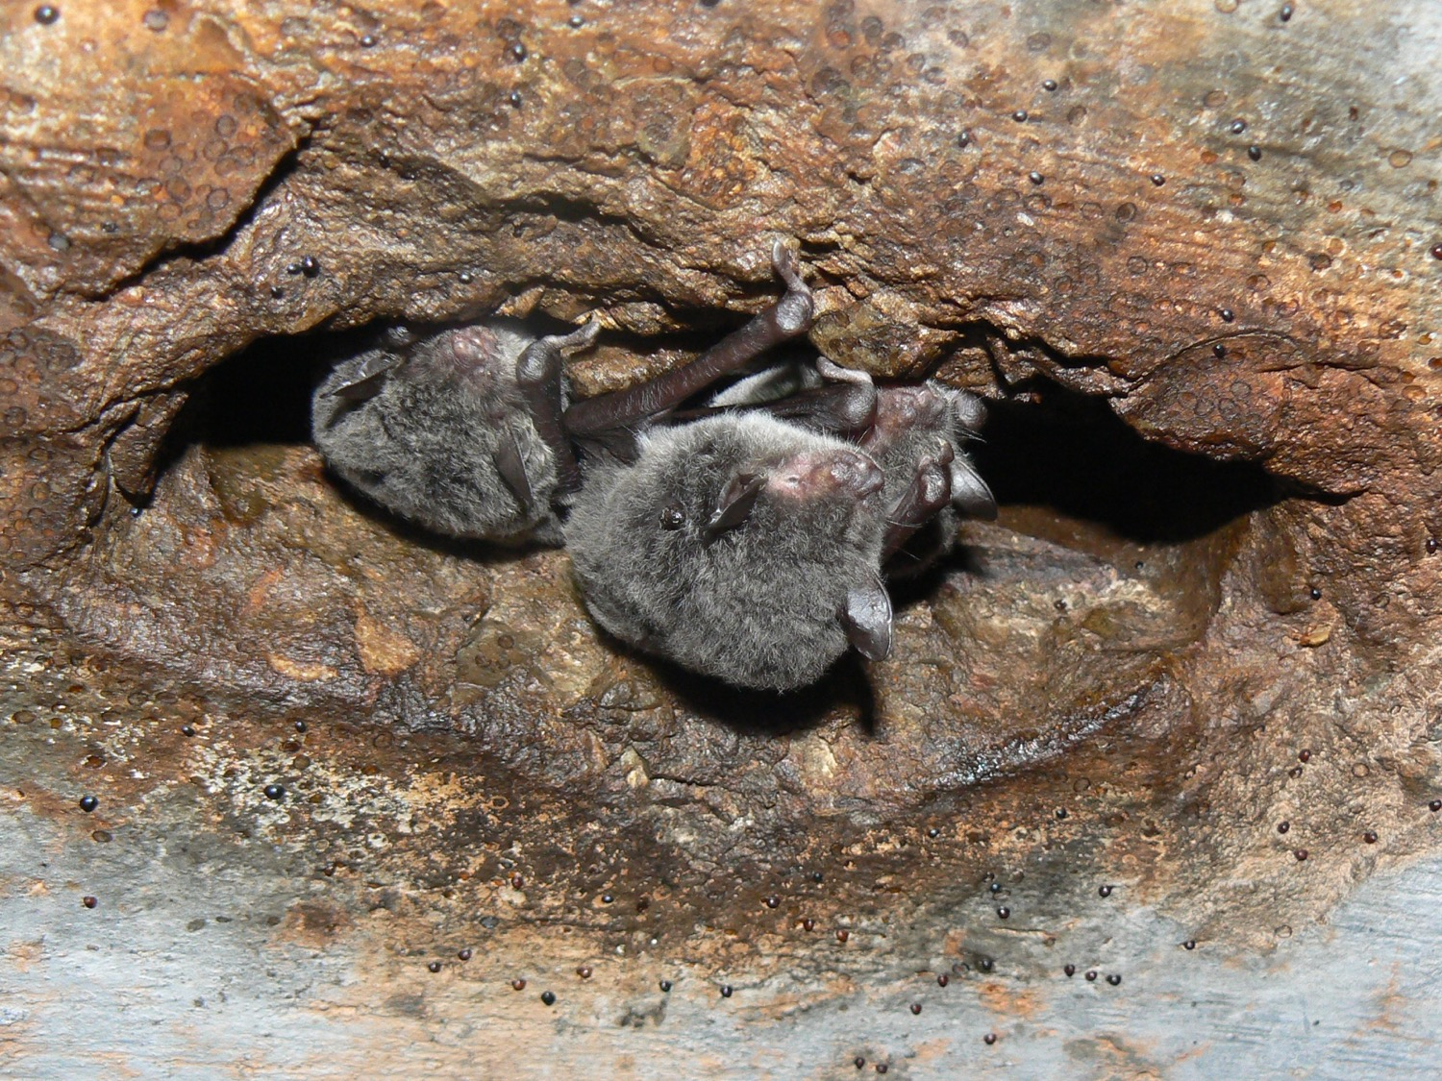
Drain holes
PHOTO: Les Hall
Notes:
Holes in old concrete drains can provide habitat for micro-bats.

Slide 9
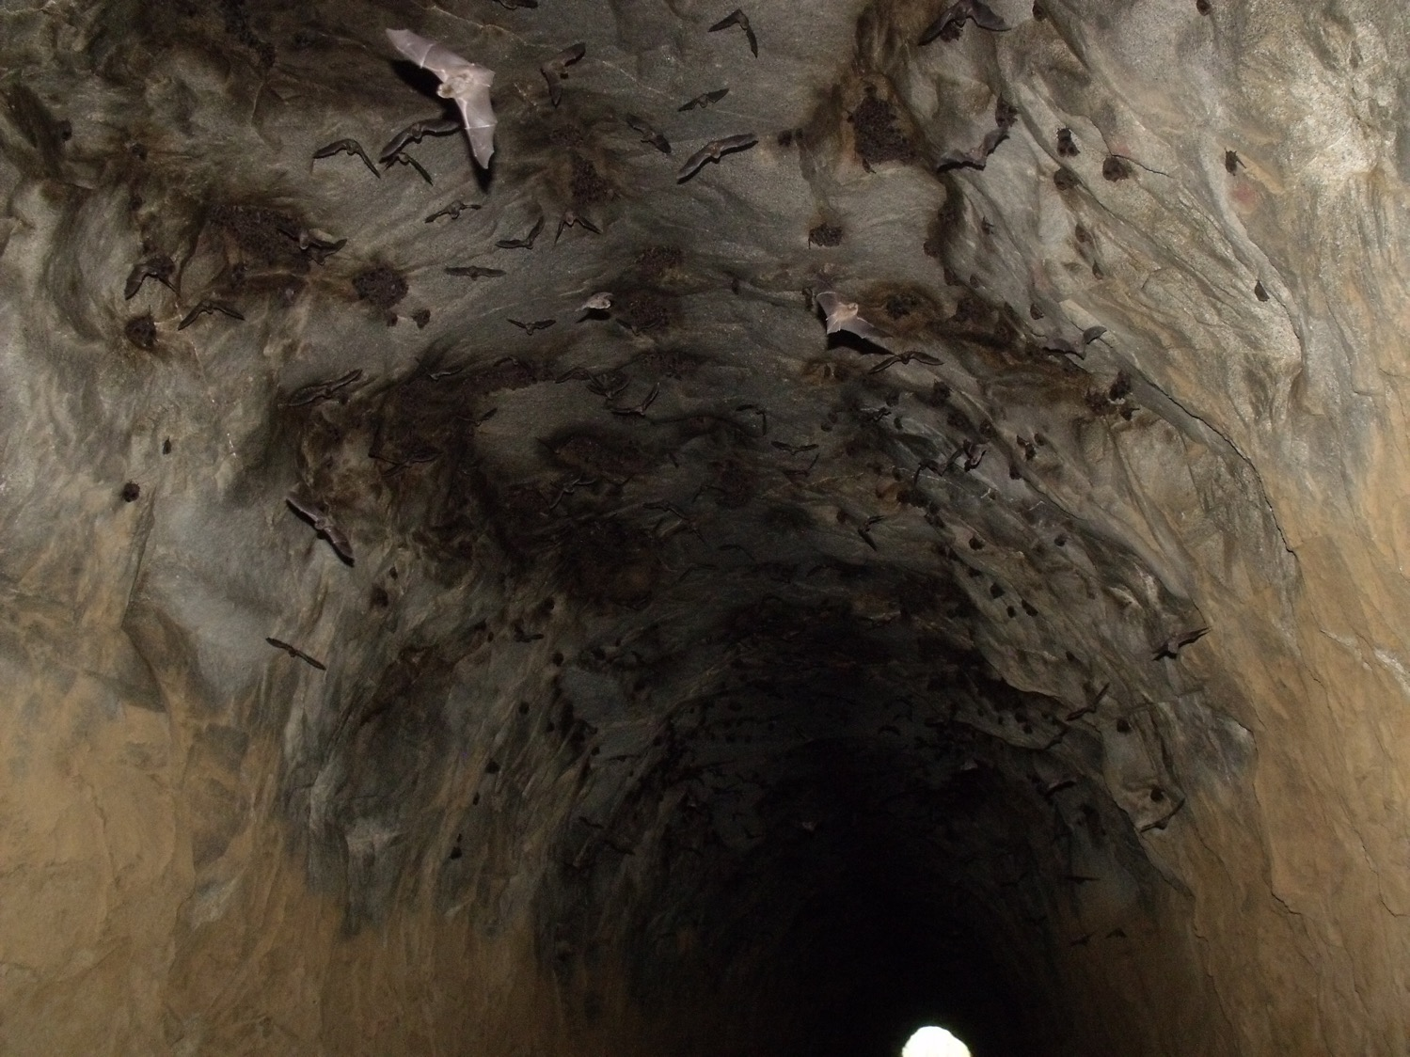
Tunnels
PHOTO: John Parsons
Notes:
Cave-dwelling micro-bats will utilise tunnels and abandoned mine shafts to roost in.

Slide 10
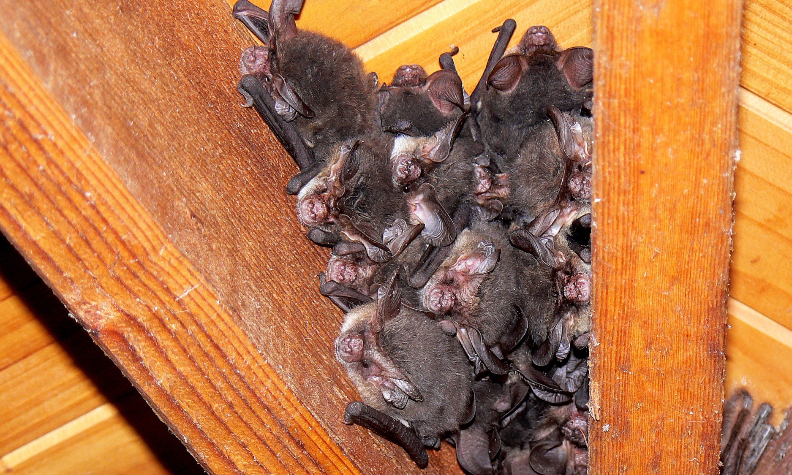
Buildings
PHOTO: Les Hall
Notes:
Micro-bats can often be found in houses or other buildings where there is safety and warmth and no other natural roosts can be found.

Slide 11
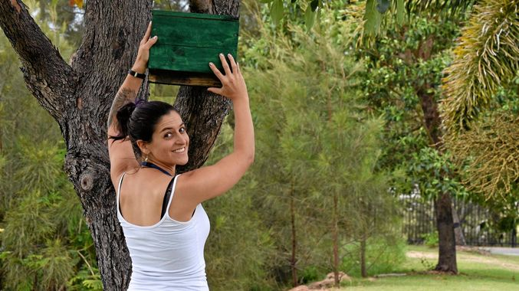
How can we help?
Micro-bats need:
Forests, old trees, hollows
Abundant food
Places they wont be disturbed
We can help by:
Stop clearing forests and old trees
Installing bat boxes where old trees have been removed
Reduce the use of pesticides around the home and on farms
Know where micro-bats are roosting and leaving them alone
Learning more about micro-bats
Telling others about micro-bats
PHOTO: University of the Sunshine Coast

Slide 12
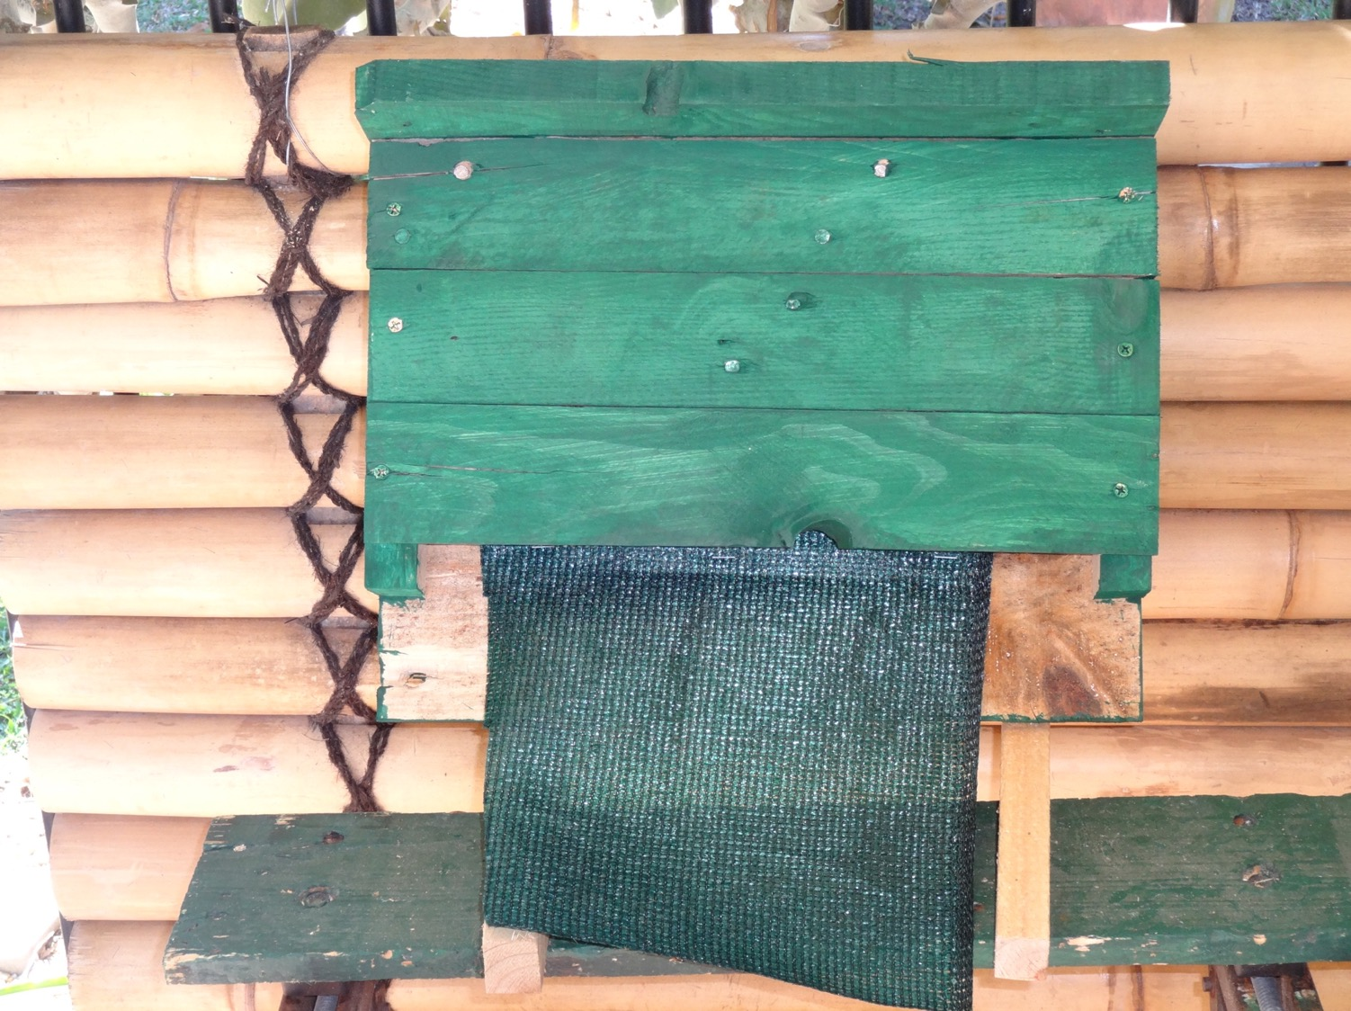
bat boxes
PHOTO: John Parsons
Notes:
Bat boxes are artificial roosts that can be erected on trees for micro-bats to roost in during the day.
These can be made at home or in school.

Slide 13
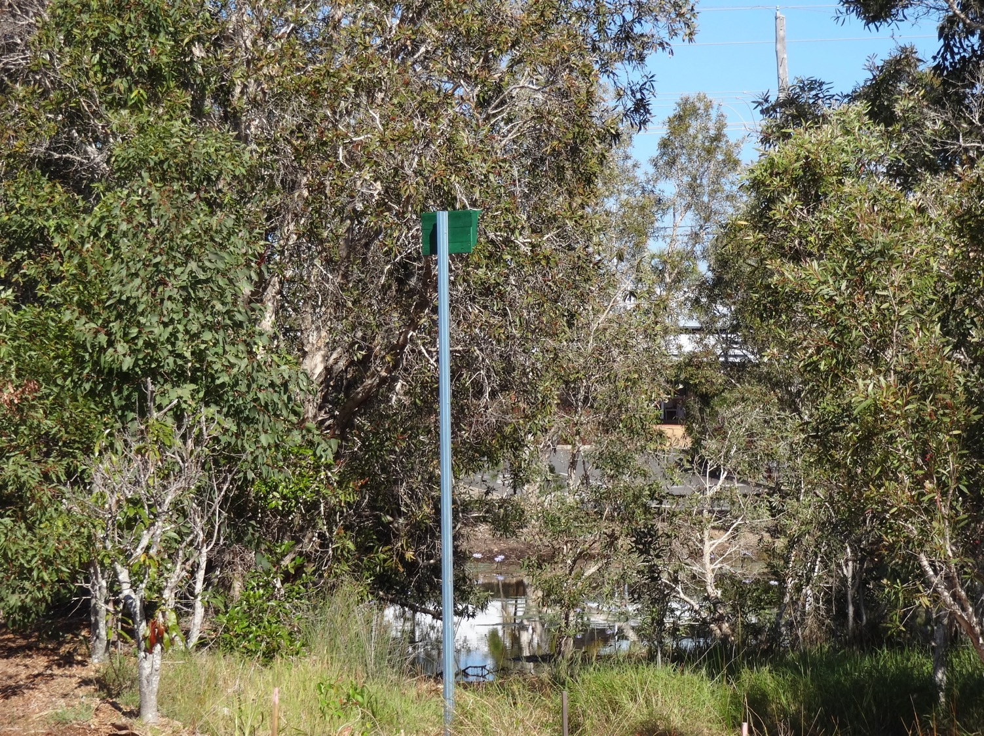
bat Poles
PHOTO: John Parsons
Notes:
Bat Poles are bat boxes erected on pole to help prevent other animals taking over the Bat Boxes.
These are being trailed in the Burnett Mary region.

Slide 14
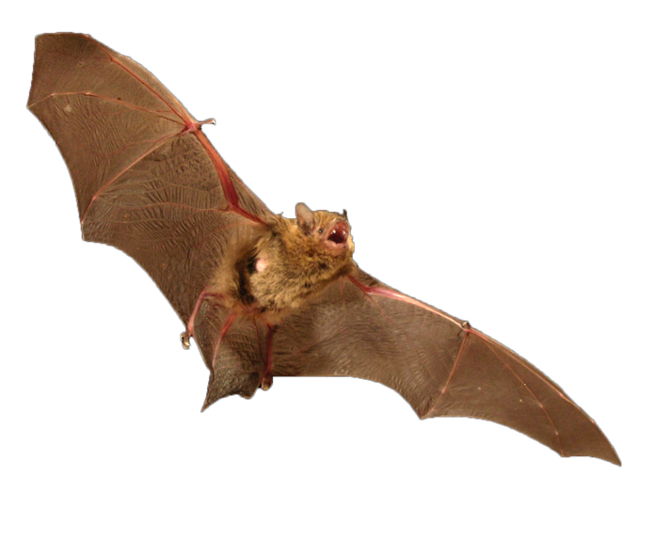
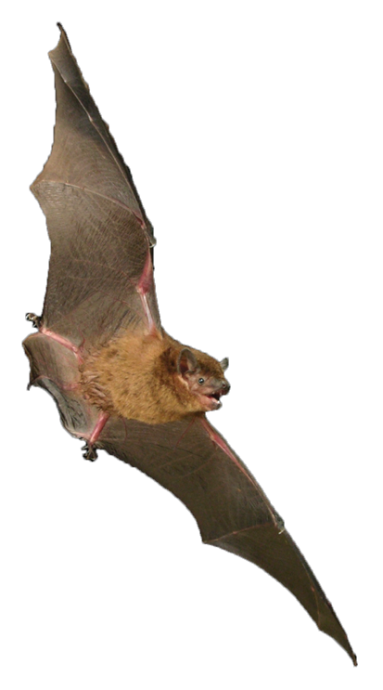
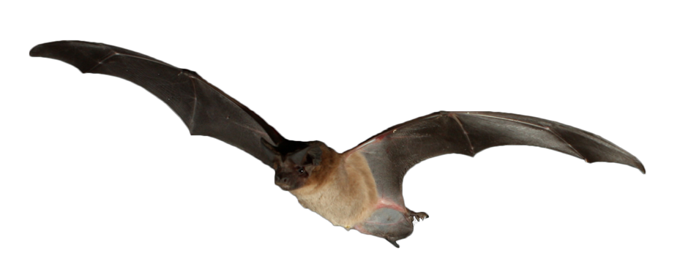

allaboutbats.org.au
Burnett Mary Micro-Bat Education Kit: Investigating Insectivores
© 2018 PeeKdesigns
This project is supported by Burnett Mary Regional Group for Natural Resource Management Ltd, through funding from the Australian Government’s National Landcare Program.
PHOTOS: Michael Pennay

